Slide 1
PartyGuard Web Application
1

Slide 2
Outline
Team Members
Team Members Responsibilities
Client Information
PartyGuard Web Application Description
Modules and functionalities
Technology Stack
Demo
Challenges
Lessons Learnt
Team 52 - PartyGuard Web Application
2

Slide 3
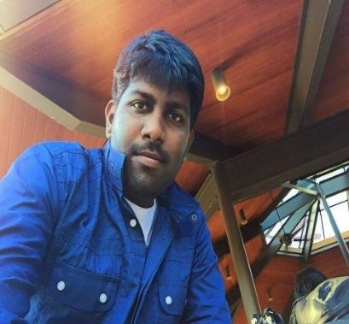
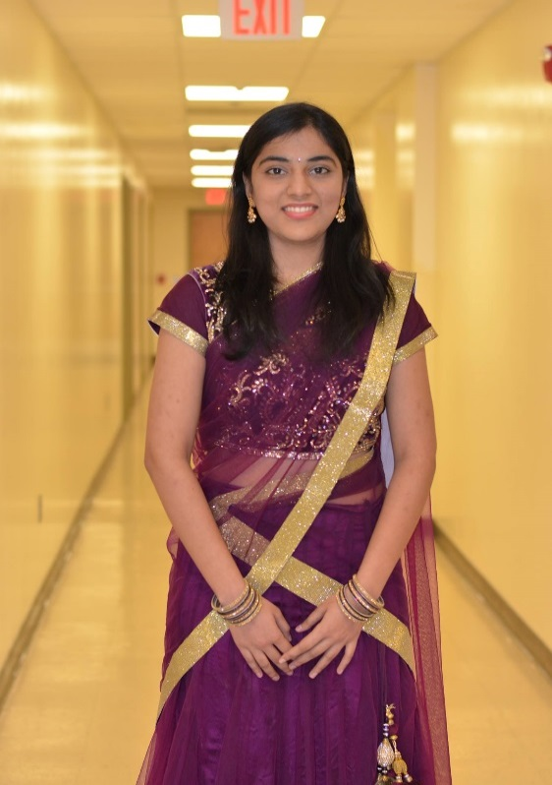
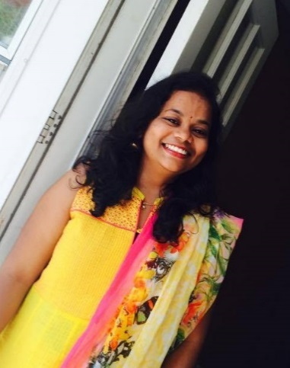
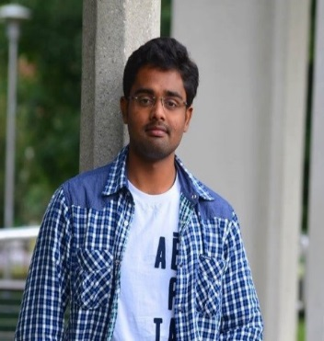
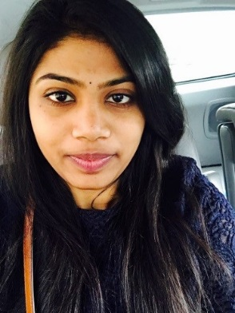
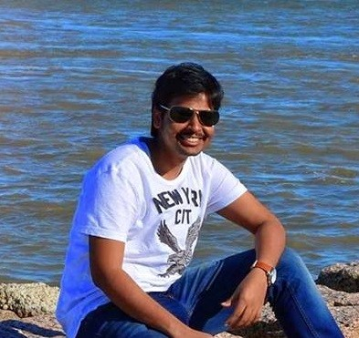
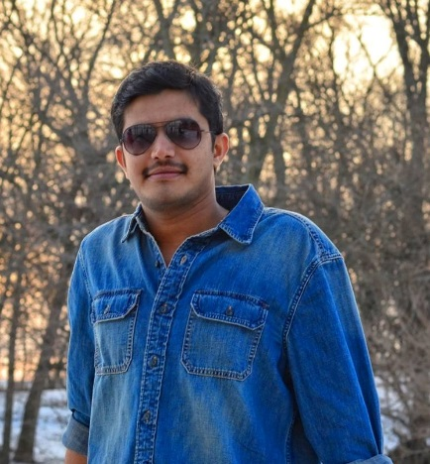
Team Members
Abishai
Nihitha
Sindhuja
Srichaitanya
Spandana
Lokesh
Gopinadh
3
Team 52 - PartyGuard Web Application

Slide 4
Team Member Responsibilities
Role | Team Member
Primary Contact | Prem Abishai Parise
Client Management | Nihitha Reddy Bhimireddy
Requirements Management | Lokesh Reddy Pothapu
Data Management | Srichaitanya Peddinti
Issues Management | Sindhuja Pannala
Quality and Testing Management | Spandana Velaga
Communications and Documentation Management | Gopinadh Cherupally
Team 52 - PartyGuard Web Application
4

Slide 5

Client Information
Client mission:
To develop a web application for users
which will help them to prevent sexual
assaults and accidents happening within
Greek life specifically fraternity houses.
Jacob C Stansbury
S516098@mail.nwmissouri.edu
Team 52 - PartyGuard Web Application
5

Slide 6
PartyGuard-Web Application
It is a web application which will be accessible to three kinds of users (i,e Master user, Host user, Guard user and Basic user)
This application will offer service to subscribed fraternity houses only
Then the subscribed fraternity can use PartyGuard in their social gatherings to create a safe environment
This PartyGuard web application works in coordination with Android application and iOS application
Team 52 - PartyGuard Web Application
6

Slide 7
Modules
Admin User
Admin
Dashboard.html
Dashboard.js
AddCustomer.html
AddCustomer.js
Module
View
Controller
ViewCustomers.html
Addack.html
Addack.js
ViewCustomers.js
Team 52 - PartyGuard Web Application
7

Slide 8
Modules(Contd..)
Host User
Host
HostProfile.html
HostProfile.js
Events.html
Events.js
Module
View
Controller
HouseLocation.html
EditEvents.html
EditEvents.js
HouseLocation.js
Members.html
Members.js
NewCustomer.html
NewCustomer.js
8
Team 52 - PartyGuard Web Application

Slide 9
Modules(Contd..)
Guard User
Guard
GuardProfile.html
GuardProfile.js
GuardRegistration.html
GuardRegistration.js
Module
View
Controller
Team 52 - PartyGuard Web Application
9

Slide 10
Modules(Contd..)
Basic User
Basic
BasicProfile.html
BasicProfile.js
Module
View
Controller
Team 52 - PartyGuard Web Application
10

Slide 11







Tools and Technologies Stack
Web Technologies
Team 52 - PartyGuard Web Application
11

Slide 12



Tools and Technologies Stack (Contd..)
Tools
Team 52 - PartyGuard Web Application
12

Slide 13


Tools and Technologies Stack (Contd..)
Version Control
Database
Team 52 - PartyGuard Web Application
13

Slide 14


Tools and Technologies Stack (Contd..)
Deployment
14
Team 52 - PartyGuard Web Application

Slide 15
What’s new?
Master User
Added dashboard
Implemented dynamic data binding functionality between Add Customer page and Add Acknowledgement page
Provided validations
Team 52 - PartyGuard Web Application
15

Slide 16
What’s new? (Contd..)
Host User
Provided edit option to host profile and the changes can be viewed
Implemented dynamic data binding functionality between Host Profile page and Host Profile Edit page
Redesigned Change House Location page and implemented Google Maps API functionality
Implemented API functionality to capture Event details which includes Event Name, Event Date , Event Time and Guards assigned
Team 52 - PartyGuard Web Application
16

Slide 17
What’s new?(Contd..)
Guard User and Basic User
Provided edit option to Guard user and Basic user profile and the changes can be viewed
Implemented dynamic data binding functionality between Profile page and Profile Edit page
Team 52 - PartyGuard Web Application
17

Slide 18
What’s new?(Contd..)
Deployment
Hosted our PartyGuard Web Application in Heroku App temporarily
Team 52 - PartyGuard Web Application
19

Slide 19
Demo
https://partyguard.herokuapp.com/
Team 52 - PartyGuard Web Application
19

Slide 20
Challenges
Email functionality in PartyGuard Web Application home
page
Need to integrate API with the web application
Team 52 - PartyGuard Web Application
20

Slide 21
Future Tasks
Integrate all webpages with API to make them dynamic.
Thorough testing before delivering the end product.
Host the site in Azure to make it available to everyone.
Provide production support to make application stable.
Team 52 - PartyGuard Web Application
21

Slide 22
PartyGuard iOS Application
22
Team54- PartyGuardiOS
ALLPPT.com _ Free PowerPoint Templates, Diagrams and Charts

Slide 23
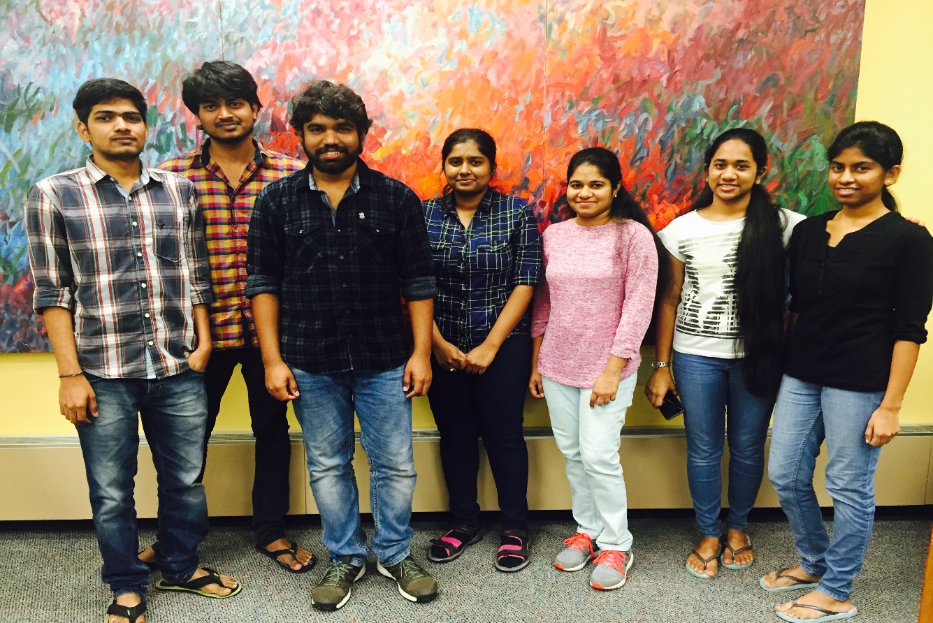
Team Members
Team54- PartyGuardiOS
23

Slide 24
Roles & Responsibilities
Role | Name
Primary contact | Satya Radha Addala
Client management | Bhavana Pilli
Requirements management | Sri Harsha Yadav Rachakunta
Data management | Harika Danala
Issues management | Harish Kola
Quality and testing management | Prasanth Butna
Communications and documentation management | Mounica Ramini
Team54- PartyGuardiOS
24

Slide 25
PartyGuard-iOS
Developing an iOS mobile application for users to prevent sexual assaults and accidents happening in fraternity houses.
Main goal of application is to protect women.
Girls who went to fraternity events can raise request for help using this free app in their mobiles.
Team54- PartyGuardiOS
25

Slide 26
Collaboration
We will be working closely with the PartyGuard Web Services team (Megatrons) throughout our project.
The Web Services team will be providing the API links and that data will be used in our mobile application.
Team54- PartyGuardiOS
26

Slide 27





Tools & Technologies used
Team54- PartyGuardiOS
27

Slide 28
Progress
Integrated five web services into the app provided by web services team.
Implemented call backs for basic user functionality.
Host Screens design and implementation using the static data is completed.
Tested Login, Registration, Forgot Password, Edit Profile functionalities.
Making appropriate changes when issues were raised.
Team54- PartyGuardiOS
28

Slide 29
Future Tasks
Integrate remaining services.
Handle push notification.
Test the remaining flows and also the whole application.
Resolve all the issues.
Team54- PartyGuardiOS
29

Slide 30
Challenges
Uncertain behavior of the web services.
Integrating other web services which are yet to be provided by Megatrons.
Handling push notifications.
Team54- PartyGuardiOS
30

Slide 31
DEMO
Team54- PartyGuardiOS
31

Slide 32
PartyGuard IOS App
BASH GUARDIANS
32

Slide 33
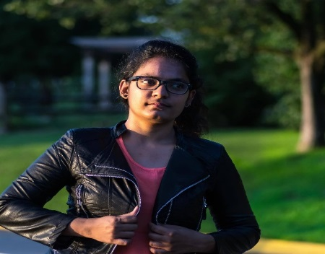
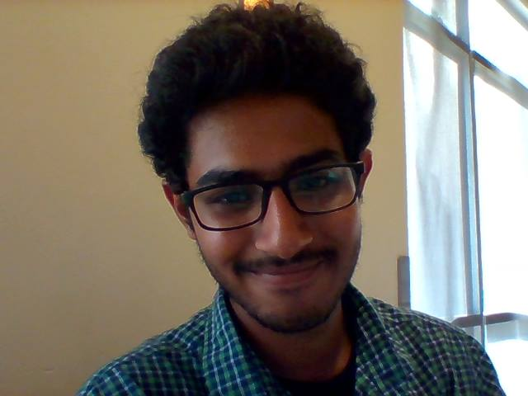
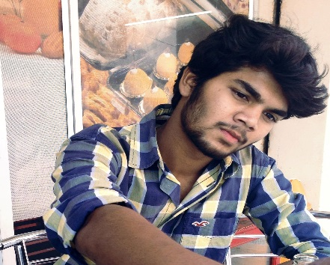
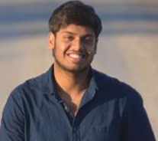
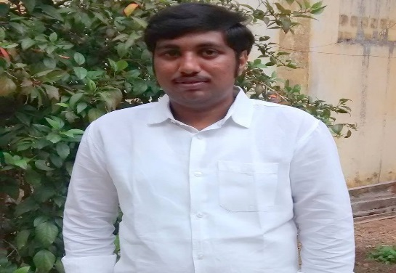
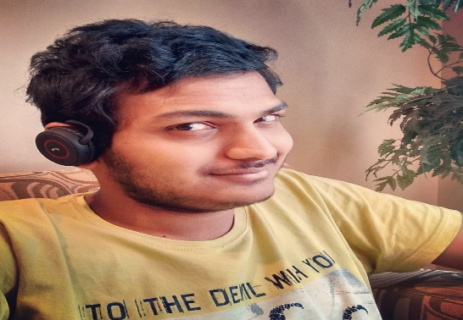
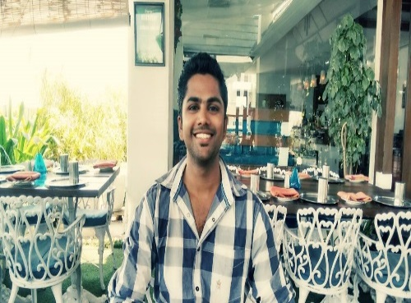
Team Members
Sai Spandana
Nandeesh
Vinod Somu
Pushpak
Sai Naveen
Sanjeev
Yashwanth
Team 21 – PartyGuard BashGuardians
33

Slide 34
Team Member Responsibilities
Role | Team Member
Primary Contact | Sai Spandana Chava
Client Management | Sanjeev Koneru
Requirements Management | Nandeesh Tankasala
Data Management | Naveen
Issues Management | Pushpak
Quality and Testing Management | Yashwanth Teja
Communications and Documentation Management | Vinod Somu
Team 21 – PartyGuard BashGuardians
34

Slide 35
PartyGuard-IOS
“PartyGuard” is an IOS application that could be used by students of Northwest Missouri State University.
It is a mobile application designed for users to help prevent sexual assaults and accidents happening within Greek life, specifically Fraternity houses. There are three different types of users for this application, basic user, and the host user and guard user. The basic user creates an account through Facebook/standalone account having required contact information and identification. After the account is created they can open the application during a party to report any situation to the host user where help is needed within the fraternity Once reported, the host and guard user is responsible for resolving the conflict
Team 21 – PartyGuard BashGuardians
35

Slide 36
Technologies and Tools
Swift
Xcode
BitBucket(Source code hosting site)
Source Tree
Trello
GitHub
JIRA
Team 21 – PartyGuard BashGuardians
36

Slide 37
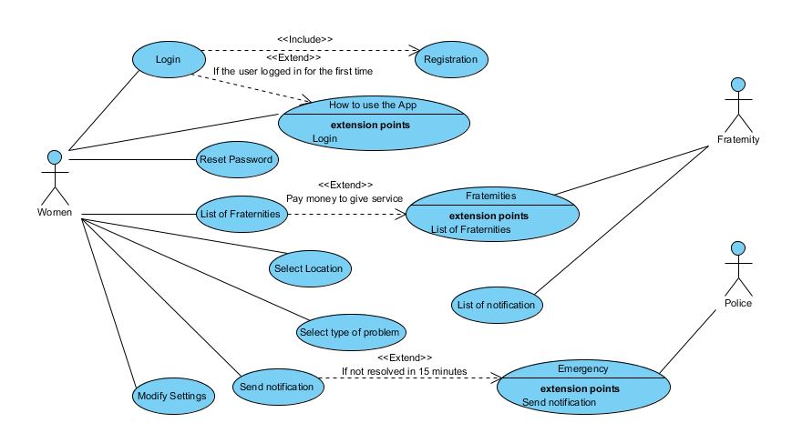
Use Case Diagram – Basic User
Team 21 – PartyGuard BashGuardians
37

Slide 38
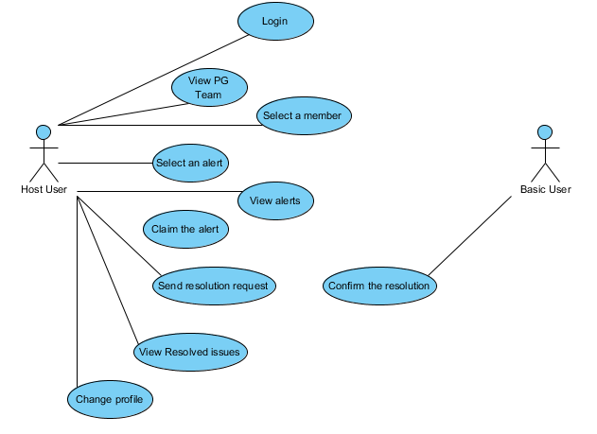
Use Case Diagram – Host User
Team 21 – PartyGuard BashGuardians
38

Slide 39
Challenges faced during Development
Talking to University Police for the application to be implemented practically.
Adding Constraints
Adding Menu
To resolve merge conflicts in bit bucket
Team 21 – PartyGuard BashGuardians
39

Slide 40
PartyGuard Demo
Team 21 – PartyGuard BashGuardians
40

Slide 41
Teams will be working with
We have collaborated with Web services team “Megatrons” to make sure that Partyguard IOS applications works with no errors.
Team 21 – PartyGuard BashGuardians
41

Slide 42
PartyGuard Android App
42

Slide 43
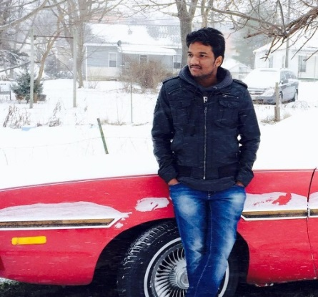
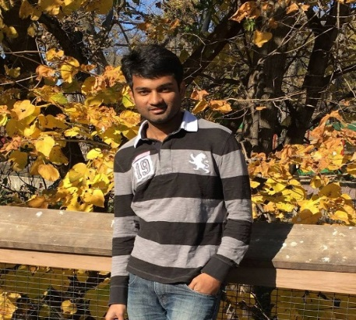
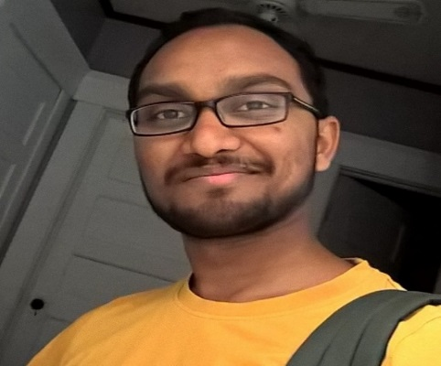
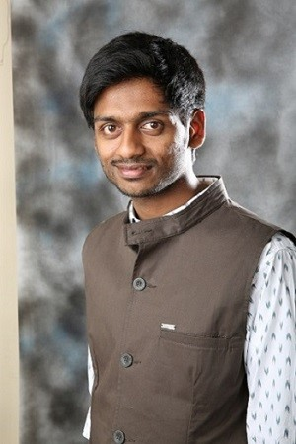
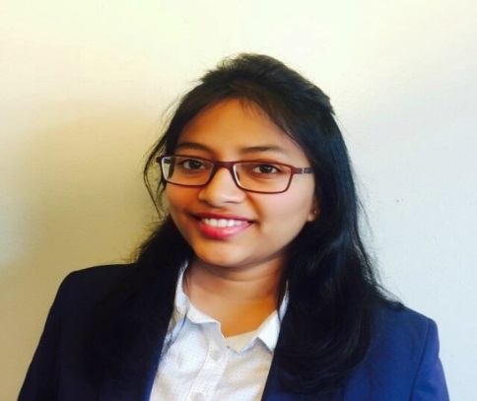
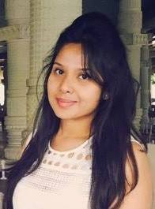
Team members
Arun Nadipudi
Nikhil Yerram
Santosh Boyina
Sreshtha Kolluru
Sharath Regonda
Sanjana Somisetty
43

Slide 44
Team Member Responsibilities
Role | Team Member
Primary Contact | Nikhil Yerram
Client Management | Nikhil Yerram
Requirements Management | Santosh Boyina
Data Management | Sanjana Somisetty
Issues Management | Sharath Regonda
Quality and Testing Management | Arun Nadipudi
Communications and Documentation Management | Sreshtha Kolluru
Team 42 – PartyGuard Android
44

Slide 45
Client Information
Name : Jacob Stansbury
Email : S516098@mail.nwmissouri.edu
Mission : To get an Android app for the safety of women at parties.
Team 42 – PartyGuard Android
45

Slide 46
Technologies
Android Studio
Java
BitBucket and SourceTree as version control tools.
EngageUAT.
Team 42 – PartyGuard Android
46

Slide 47
Work Done Previously
In the previous demo, we have showed 80% of the user interface of our application.
We have provided navigation from one page to another.
The client was pleased with our user interface and provided minor changes to it.
And, all the data was static.
Team 42 – PartyGuard Android
47

Slide 48
Work Done from Previous Client Demo
In the past few weeks, we have developed the remaining user interface of our application.
We have written code for connecting our application with the services.
We have written registration and login service code.
Because of the unavailability of services we could not test them.
In order for our basic user core functionality to work, we are working on push notifications and SQLite database to send alert.
Team 42 – PartyGuard Android
48

Slide 49
PartyGuard Demo
Team 42 – PartyGuard Android
49

Slide 50
Future Tasks
Write the code for remaining services and integrate.
Try to provide auto login for our application.
Achieve the core functionality features.
Team 42 – PartyGuard Android
50

Slide 51
PartyGuard Android App
51

Slide 52
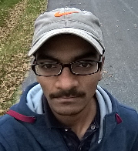

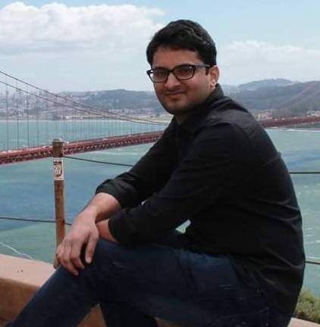
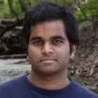
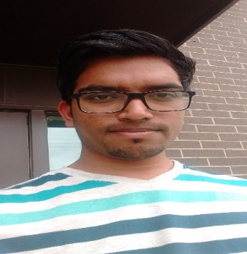
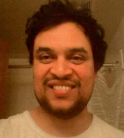
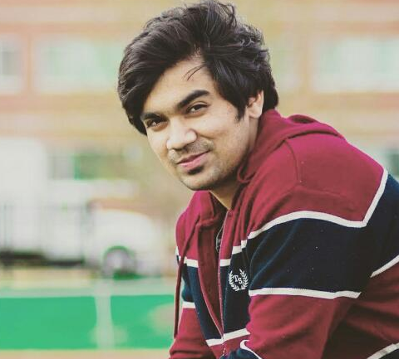
Team Members
Harish Yanala
Rakshith
Vinod Kumar
Seshu
Harish Yeddluri
Sridhar
Ashish Peruru
Team 41 – PartyGuard AndroidNachos
52

Slide 53
Team Member Responsibilities
Role | Team Member
Primary Contact | Rakshith Anand
Client Management | Vinod Kumar Kurma
Requirements Management | Seshu Kumar
Data Management | Sridhar Yerasi
Issues Management | Harish Yanala
Quality and Testing Management | Ashish Peruru
Communications and Documentation Management | Harish Yeddluri
Team 41 – PartyGuard AndroidNachos
53

Slide 54
PartyGuard-Android
“PartyGuard” is an Android app that could be used by students of Northwest Missouri State University.
During a party at a fraternity house, if a person faces any problem, she can report about that issue to the fraternity members. She can report about various problems like fights, someone is too drunk/sick, inappropriate behavior, and assaults of any kind. The fraternity members can view the reported notifications and they will send the rescue team to the spot. Separate to these other alerts, the emergency button feature will have a running timer and if the problem is not solved within 15 minutes an alert message will be sent to campus police.
Team 41 – PartyGuard AndroidNachos
54

Slide 55





Technologies and Tools
Java
Android Studio
Geny Motion(Emulator for Android)
BitBucket(Source code hosting site)
Source Tree
Lint(Code scanning tool for Android Studio)
Team 41 – PartyGuard AndroidNachos
55

Slide 56
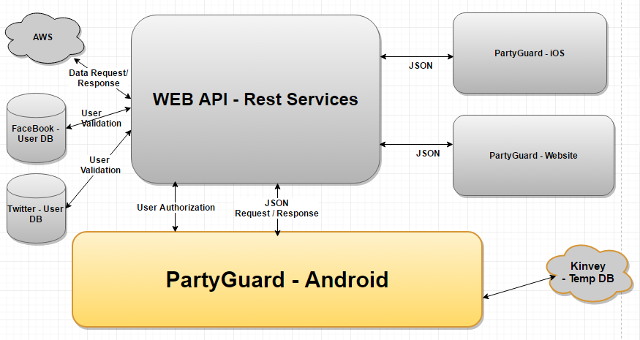
PartyGuard Architecture
Team 41 – PartyGuard AndroidNachos
56

Slide 57
App Deployment
During development, we are planning to deploy this app to a mobile or a tablet.
We will be providing demo using Vysor app.
Note: Vysor app lets you view and control your Android on your computer.
For production, Android apps can be published only through google store
Developers need to register for a Google Play publisher account
Details about publishing the app
https://developer.android.com/distribute/googleplay/start.html
Team 41 – PartyGuard AndroidNachos
57

Slide 58
PartyGuard Demo
Team 41 – PartyGuard AndroidNachos
58

Slide 59
Team Dependencies
We would need to work with Rest Services team
Android app needs to integrate with REST services to perform CRUD operations on AWS data.
Team 41 – PartyGuard AndroidNachos
59

Slide 60
Challenges faced during Development
Integration with services team as the development is happening in parallel
Resolving merge conflicts
Developing custom controls
Integrating our app with S3 cloud(Amazon AWS)
Depricated methods in android
Finding time
Team 41 – PartyGuard AndroidNachos
60

Slide 61
PartyGuard WebServices
61

Slide 62
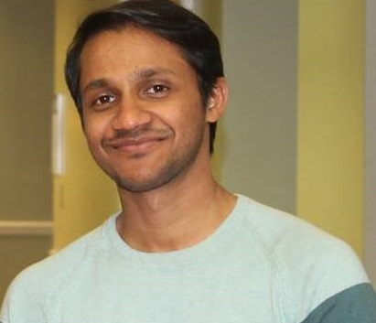
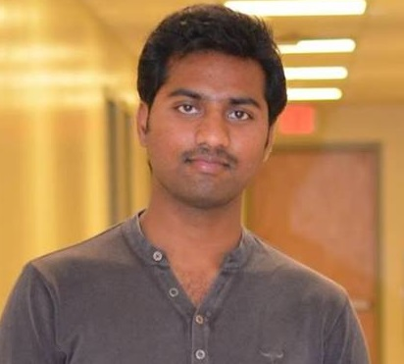
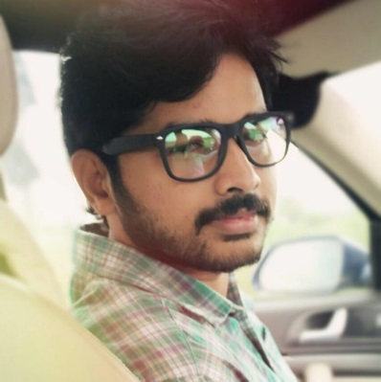
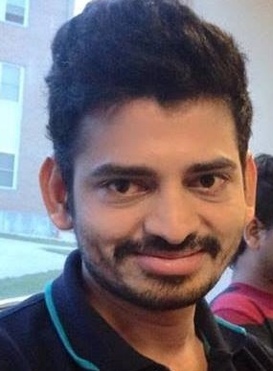
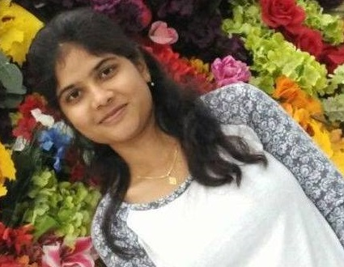
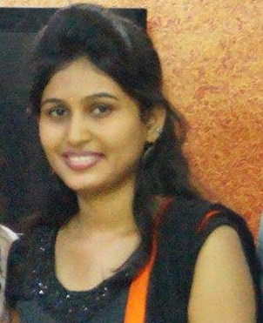
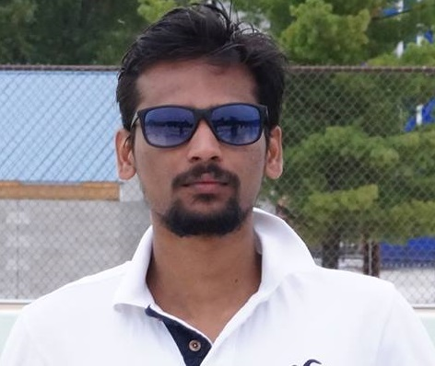
PRASUNJIT
MANOJ
SRIKANTH
SAIRAGHAVA
NAVYA
TARUNI
SAIRAM
62
Team 22 - PartyGuard WebServices

Slide 63
Team Member Responsibilities
Primary Contact: Prasunjit Nayak
Client management: Manoj Kumar Are
Requirements management: Srikanth Chippa
Data management: Taruni Bollu
Issues management: Navya Bachati
Quality and testing management: Sairam Madhavaram
Communications and documentation management: Raghava Singamneni
Team 22 - PartyGuard WebServices
63

Slide 64
PartyGuard WebSevices
Overview:
The API Web Services will provide a common interface for Web and mobile(iOS, Android) clients to interact with the back end database.
Artifacts produced
Database ER Design
Database attributes
System Requirement Specification
REST Services API
64
Team 22 - PartyGuard WebServices

Slide 65
Basic user registration & login
Basic User registration
Url: http://partyguardrestservices2016.azurewebsites.net/api/Account/Register
Request type: JSON(application/json)
request data:
{
"Email" : "srikanth@gmail.com",
"Password" : "Password_456",
"ConfirmPassword":"Password_456",
"firstName":"srikanth",
"lastName":"ch",
"PhoneNumber":"6605415452",
"userType":"basic"
}
Note: age, imgUrl are optional
Method: post
Status: 200 OK
65
Team 22 - PartyGuard WebServices

Slide 66
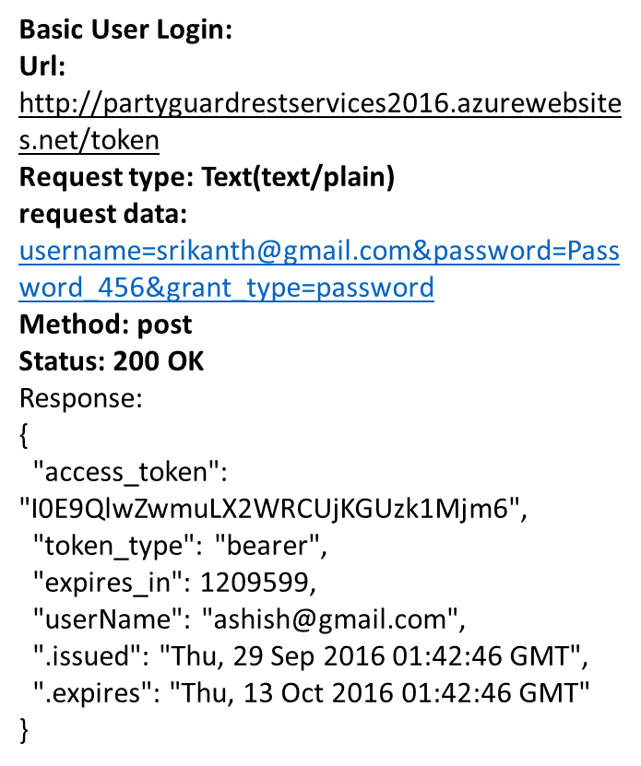
66
Team 22 - PartyGuard WebServices

Slide 67
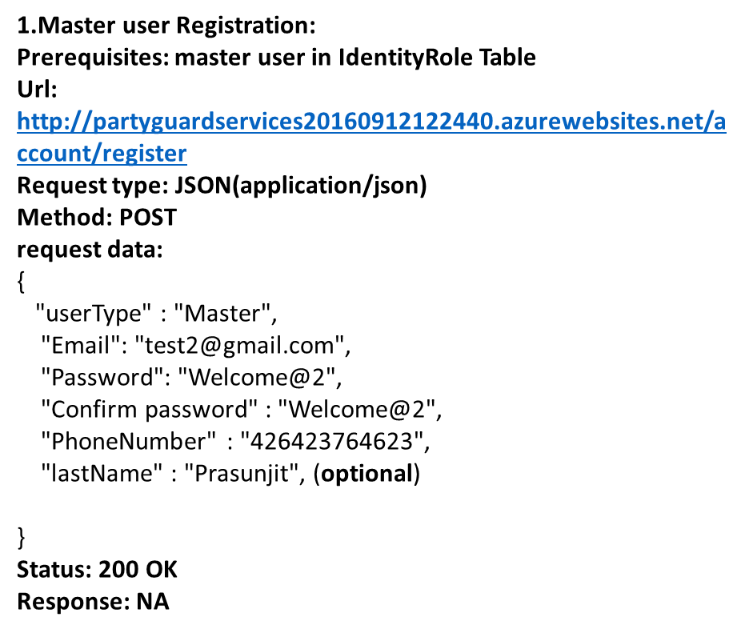
Master user registration & login
67
Team 22 - PartyGuard WebServices

Slide 68
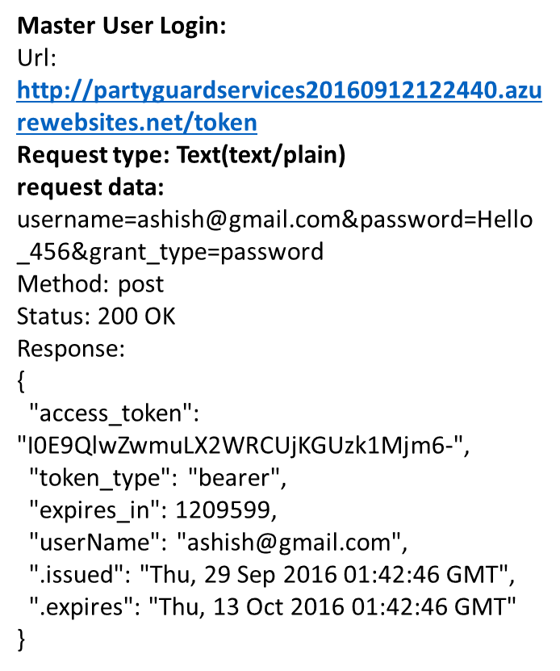
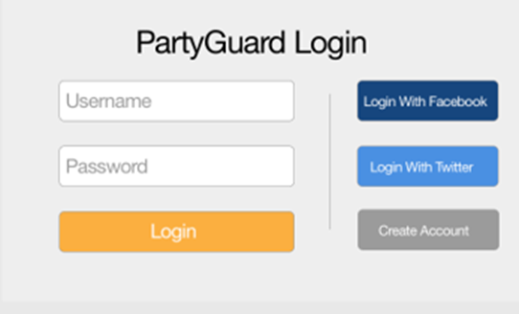
68
Team 22 - PartyGuard WebServices

Slide 69
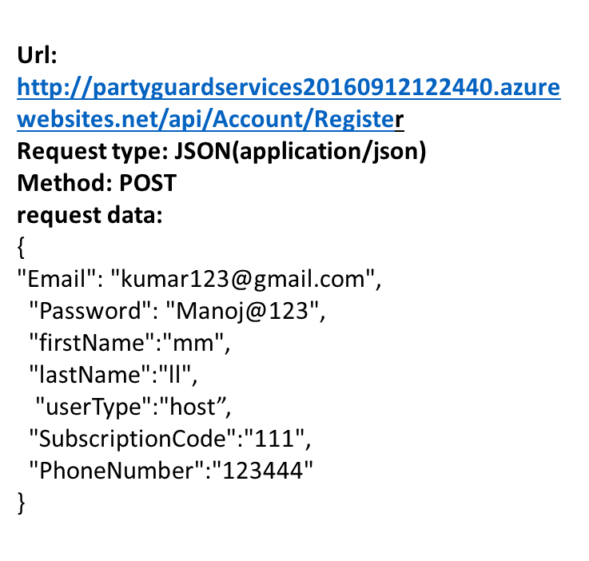
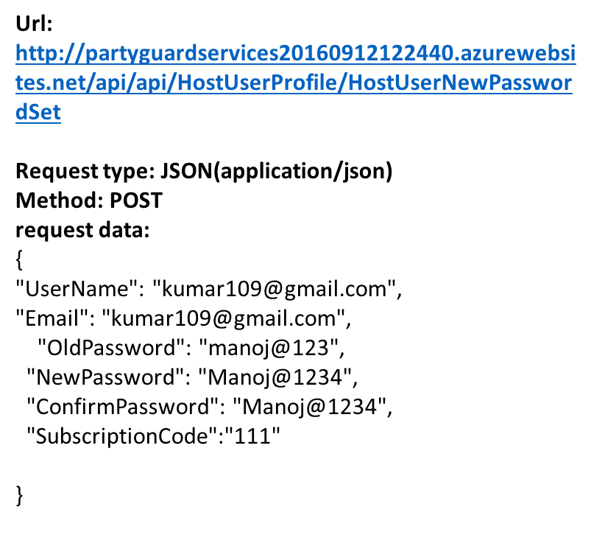
Host User registration and login
69
Team 22 - PartyGuard WebServices

Slide 70
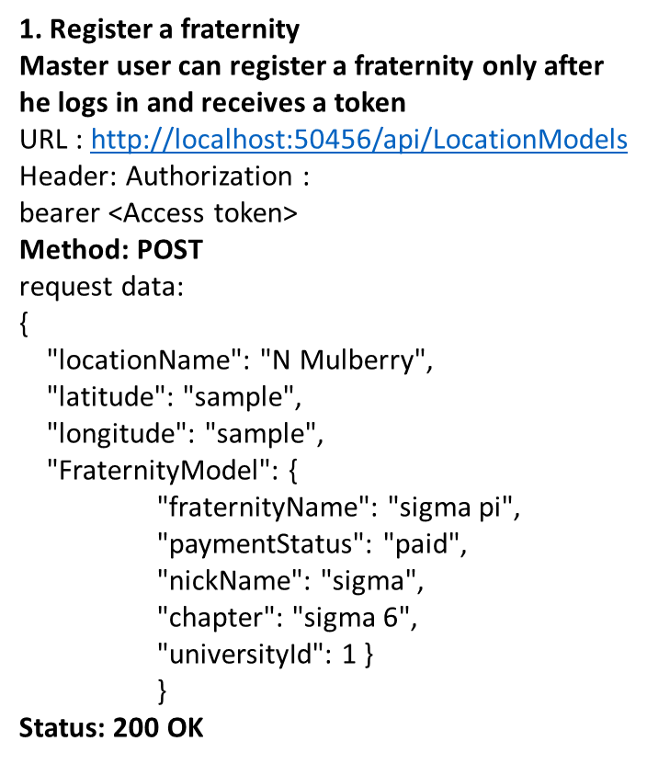
Fraternity registration in Master View
70
Team 22 - PartyGuard WebServices

Slide 71
Conclusion
71
Team 22 - PartyGuard WebServices

Slide 72
Thank You
72
Team 22 - PartyGuard WebServices

